Slide 1
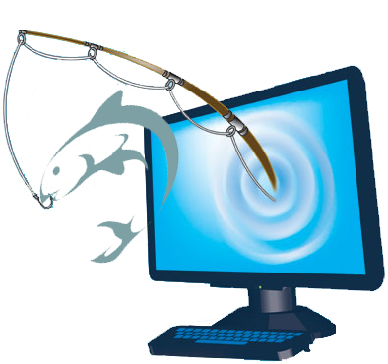
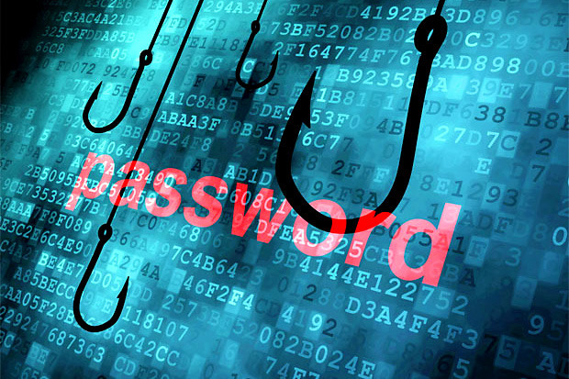

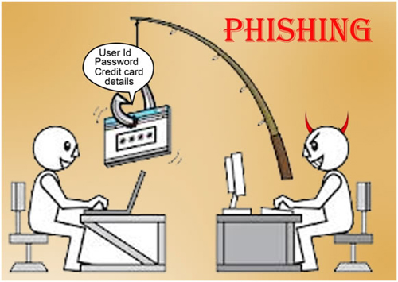
computer phishing

Slide 2
What is computer phishing
computer phishing is a scam used to get personal information like you bank account details or passwords.
A lot of the time computer phishing can be used to get IP addresses. Your IP can then be used by a hacker to get other information e.g. for example your home address.
computer phishing will normally be in the form of a website and need the user to enter their bank account information or other information.

Slide 3
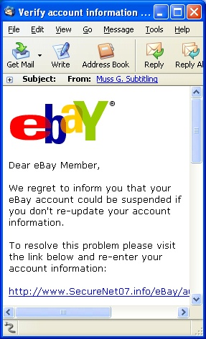
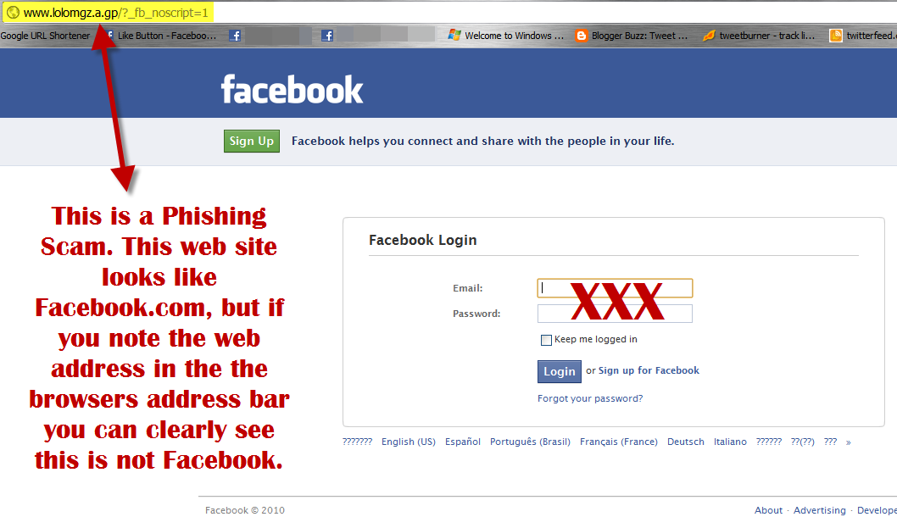
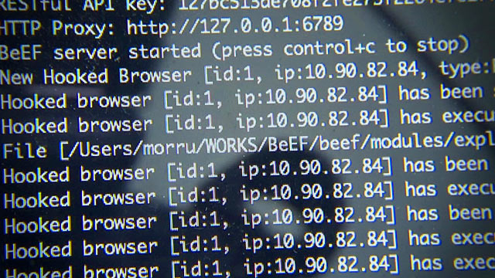
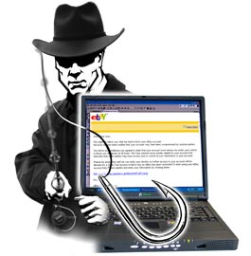
How to protect your self from computer phishing
Be wary of emails asking for confidential information
Don't get pressured into providing sensitive information
Watch out for generic-looking requests for information
Make sure you maintain effective software to combat phishing.

Slide 4
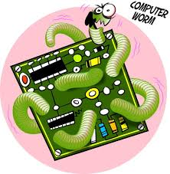
Computer Worms
By Charlotte Savine

Slide 5
What is a computer Worm?
A Computer Worm is an infecting program that can spread on your computer by replicating itself.

Slide 6
What damage it can do
A Computer Worm can take over a computer system and control the computer and can steal the computers data. It can also delete files. The controlled computer can be used to attack systems that belong to a business or the government.

Slide 7
Computer threats
Trojan & denial of service (DoS) attack

Slide 8
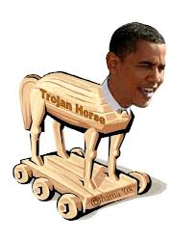
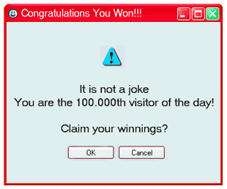
Trojan
a Trojan horse (sometime called a Trojan) is a kind software that disguises itself as something else and will ruin your computer. It can tell a complete stranger your log in details to anything. Trojan is usually attached to something that you can download and would attach to files such as music, wallpapers, backgrounds, games, and especially .exe files and so on.
Only download
things you trust

Slide 9
D-Dos
A denial of service attack know as DDoS is when a attacker sends a load of information to a service or network over running the system.
For example a company have upset a hacker, the hacker can take over loads more computers and can go on to the companies website and send to much information for the system to handle and breaks.
For example making thousands for computers to load up the website millions of times.
You can protect against this my testing if the person is human e.g. look at the photos and drag all the photos of pasta into the box (captcha)

Slide 10
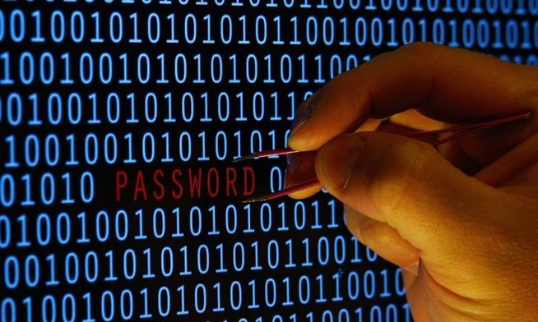
Hacking
What is hacking ? Hacking is when someone uses a network to get past security passwords to see data on another computer. Sometimes they even purposely target a certain website or company . Not all hackers can be bad some only do it for the challenge and not to corrupt a computer or a website
Unauthorised access
Brandon, Morgan and Jared

Slide 11
Physical Threats
Overheating – must keep computers cool. Processors get very hot must be cooled.
Vandalism
Fire
Floods
Power surge or power cuts – could damage the computer or lose your work.
Magnets – magnetic fields will erase your data.
To prevent this threats you should copy your work and backup

Slide 12
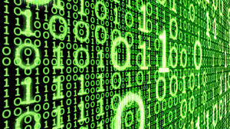
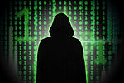
Spyware

Slide 13
What Is Spyware?
Spyware is something used by hackers and other types of people to gather information about a person or find out what the person is doing on their electronic devices.
The information is usually taken from someone and sent to someone else to examine and read through for information.
Stealing passwords

Slide 14
About spyware
Spyware is usually known as four different sectors: system monitors, trojans, adware, and tracking cookies.
Spyware is used most by people who want to track people on the internet and store information, see what they are doing and serve pop-up ads to the victim.
Spyware is usually hard to track when being used
Spyware can collect almost any type of data like personal information, internet surfing habits, user logins and bank and credit details.
Spyware can also interfere with the way a user uses their computer by installing additional software or redirecting internet browsers.

Slide 15
Computer Threats
By Jack, Piolo and Harry

Slide 16
What is a computer Virus?
A computer virus is a malware programme that when opened, will infect key areas.
In the computer, key areas such as the computer hard drive , data files and progams.
A computer virus is a piece of code that is man-made and will copy and multiply inside the computer’s key components. Even simple viruses can be dangerous.
The symptoms of a computer viruses are Slow computer performance, Erratic computer behaviour, Unexplained Data loss and Frequent computer crashes.
To prevent having a virus, firewalls and anti-virus help.

Slide 17
What is Adware?
The name ‘adware’ describes a program that forces unwanted, continuous ads that pop-up at any time.
An adware tracks everything you are doing online and advertises your current search. For example, if a person searches up a specific object to buy, it will promote that by popping up repeatedly.
There are trusted software's that help prevent adware. An obvious software is Anti-Adwares.

